Slide 1

Automotive Technology:
A Systems Approach, 8e
Chapter 8: Preventive Maintenance and
Basic Services
Rob Thompson and Jack Erjavec, Automotive Technology: A Systems Approach, 8th Edition. © 2025 Cengage. All Rights Reserved. May not be scanned, copied or duplicated, or posted to a publicly accessible website, in whole or in part.

Slide 2
Chapter Objectives
08.01 Describe the information that should be included on a repair order.
08.02 Explain how the vehicle and its systems can be defined by deciphering its VIN.
08.03 Explain the importance of preventive maintenance.
08.04 List at least six examples of typical preventive maintenance services.
08.05 Understand the differences between the types of fluids required for preventive maintenance and know how to select the correct one for a particular vehicle.

Slide 3
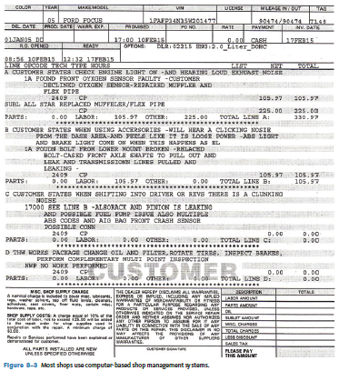
Repair Orders (1 of 3)
08.01 Describe the information that should be included on a repair order.
A repair order (RO) is written for every vehicle brought into the shop.
ROs may also be called service or work orders.
ROs contain information about the customer, the vehicle, the customer’s concern or request, an estimate of the cost for the services, and the time the services should be completed.
Completed ROs typically show the concern, cause, and correction, or the 3 Cs.
ROs are legal documents that are used for many other purposes.

Slide 4
Repair Orders (2 of 3)
Very often when a service is performed, parts are replaced and appear on the RO as “R&R,” which stands for “remove and replace.”
In a dealership, nearly all of the replacement parts are original equipment manufacturer (OEM) parts obtained through the parts department.
Parts may be:
  OEM
  Aftermarket
  Used
  Remanufactured or rebuilt
If the replaced part has no core value, the shop disposes of the part. However, many shops offer the part to the customer as proof that the part was removed and a new one installed.
In many states, the shop is required by law to either return the old parts or allow the customer to inspect them.

Slide 5
Repair Orders (3 of 3)
Some of the things to do when estimating the cost of a repair or service:
  Make sure you have the correct contact information for the customer and the correct information about the vehicle.
  Always use the correct labor and parts guide or database for that specific vehicle.
  Locate the exact service for that specific vehicle in the guide or database.
  Using the guidelines, choose the proper time allocation listed for the service.
  Multiply the allocated time by the shop’s hourly labor rate.
  If any sublet repairs are anticipated, list this service as a sublet repair and add the cost to the labor costs.

Slide 6
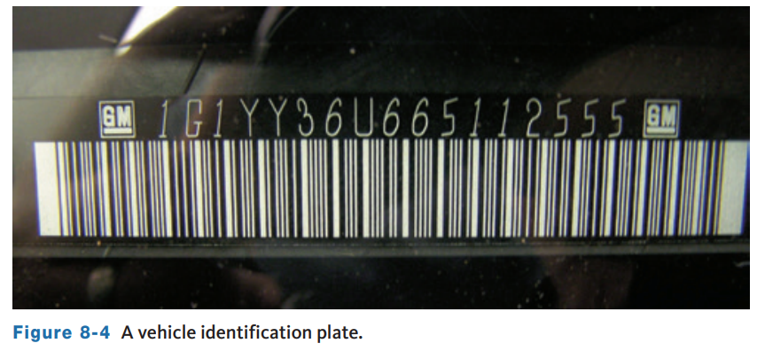
Vehicle Identification (1 of 2)
08.02 Explain how the vehicle and its systems can be defined by deciphering its VIN.
Refer to the vehicle’s identification number (VIN) before doing any service to a vehicle to know exactly what you are working on.
The VIN is on a plate behind the lower corner of the driver’s side of the windshield as well as other locations on the vehicle.
It is made up of 17 characters and contains all pertinent information about the vehicle.

Slide 7
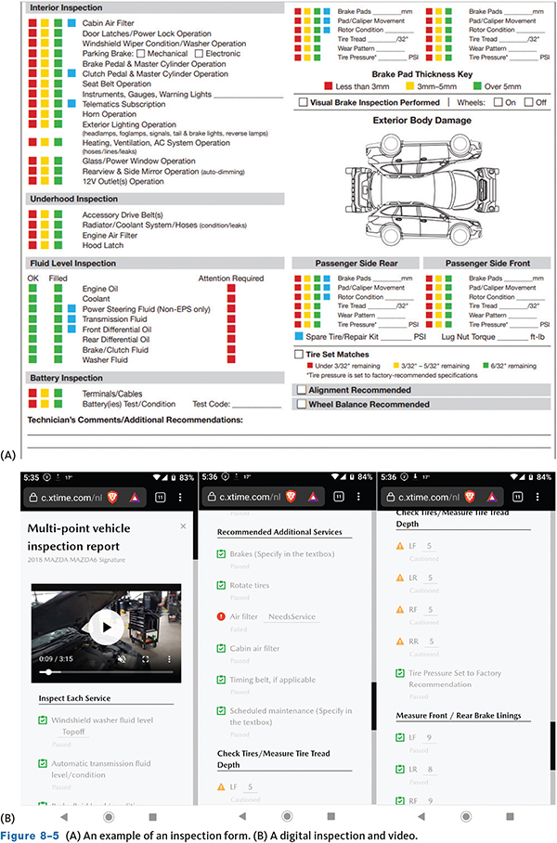
Vehicle Identification (2 of 2)
Vehicle Inspection
  Most shops have some type of formalized inspection process.
  Inspect the outside of the vehicle for obvious damage and should be noted before work begins.
  Making notes about any damage that is present before service can help prevent problems.

Slide 8
Preventive Maintenance (1 of 2)
08.03 Explain the importance of preventative maintenance.
Preventive maintenance (PM) involves performing certain services to a vehicle on a regularly scheduled basis before there is any sign of trouble.
Regular inspection and routine maintenance can prevent major breakdowns and expensive repairs and also keeps cars and trucks running efficiently and safely.
A 2012 study found that the average age of passenger cars in the United States is over 11 years old and increasing year over year.
PM is critical for all vehicles including new, but especially critical for keeping older vehicles safe and on the road.

Slide 9
Preventive Maintenance (2 of 2)
A survey of 2,375 vehicles conducted during National Car Care Month found that more than 90 percent of the cars lacked some form of service.
The results indicated that:
  34% of the cars had restricted air filters
  27% had worn belts
  25% had clogged PCV filters
14% had worn hoses
20% had bad batteries, battery cables, or terminals.
39% failed due to bad or contaminated transmission or power-steering fluid
36 % had worn-out or dirty engine oil
28% had inadequate cooling system protection,
8% had a faulty radiator cap.
50% failed due to worn or improperly inflated tires
32% had inoperative headlights or brake lights
14% had worn wipers.

Slide 10
Basic Services
Service Bulletin and Recall Check
When a vehicle is brought in for service, the shop management system will often perform a bulletin and recall check based on the VIN.
Even if not performed automatically, many shops will check for applicable technical service bulletins (TSBs) and recalls.
A search for TSBs often can save you time and trouble by providing you with information about a concern, an updated part or repair procedure before you spend time trying to figure out a concern on your own.
Also, it is possible that the owner of the vehicle is not aware that a recall applies to their car and alerting them can help build trust and goodwill between the customer and the shop.

Slide 11
Engine Oil (1 of 4)
Engine oil is a clean or refined form of crude oil. Crude oil, when taken out of the ground, is dirty and does not work well as a lubricant for engines so crude oil must be refined to meet industry standards.
Engine oil is specially formulated to:
  Flow easily through the engine
  Provide lubrication without foaming
  Reduce friction and wear
  Prevent the formation of rust and corrosion
  Cool the engine parts it flows over
  Keep internal engine parts clean
  Maintain compatibility with seals to prevent leaks
  Provide improved fuel economy by reducing friction
  Not cause damage to catalytic converters and oxygen sensors

Slide 12
Engine Oil (2 of 4)
08.05 Understand the differences between the types of fluids required for preventative maintenance and know how to select the correct one for a particular vehicle.
Oil is derived from a base stock of which there are four groups used in automotive engine oils, Group I to Group IV, from lowest quality to highest.
Engine oil contains many additives, each intended to improve the effectiveness of the oil.
The American Petroleum Institute (API) classifies engine oil as S-class for gasoline or “spark” ignition engines or C-class or F-class for diesel or “compression” ignition engines.
The various types of oil within each class are further rated according to their ability to meet the engine manufacturers’ warranty specifications.
Friction modifiers and other additives are used to achieve this. In addition to the API rating, oil viscosity is important in selecting engine oil.

Slide 13
Engine Oil (3 of 4)
The ability of oil to resist flowing is its viscosity. The thicker the oil, the higher its viscosity rating.
Viscosity is affected by temperature; hot oil flows faster than cold oil.
Oil flow is important to the life of an engine, and because an engine operates under a wide range of temperatures, selecting the correct viscosity is very important.
Because of changes in engine technology such as variable valve timing, placing piston rings closer to the top of the piston, and the adoption of hybrid powertrains, using the correct grade and viscosity oil is more critical than ever.
Using the incorrect weight oil can cause excessive oil consumption, increased fuel consumption, VVT system faults, and other concerns.

Slide 14
Engine Oil (4 of 4)
The Society of Automotive Engineers (SAE) has established an oil viscosity classification system that is accepted throughout the industry which utilizes a numeric rating, the higher viscosity, or heavier weight, and oils receive the higher numbers.
  For example, oil classified as SAE 50 weight oil is heavier and flows slower than SAE 10 weight oil.
Modern engine oils are multiviscosity oils. These oils carry a combined classification such as 5W-30.
The “W” after the 5 notes that the oil was tested for its cold rotational (cold cranking) ability and its pumping ability.
To formulate multiviscosity oils, polymers are blended into the oil which expand when heated.
With the polymers, the oil maintains its viscosity to the point where it is equal to 30-weight oil.

Slide 15
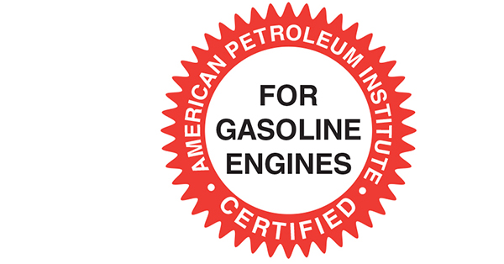
ILSAC Oil Ratings
The International Lubrication Standardization and Approval Committee (ILSAC), formed by both domestic and Japanese vehicle manufacturers, has developed an oil rating that combines SAE viscosity ratings and the API service rating.
ILSAC standards require an oil to meet specific standards for low- and high-temperature operation, deposit control, sludge control, and others.
The current ILSAC standard, introduced in 2020, is GF-6A and GF-6B.
GF-6 is formulated to offer increased high-temperature, high-shear (HTHS) performance, and reduced low speed pre-ignition (LSPI), a condition common with current turbocharged engines.
The GF-6A applies to oil viscosities ranging from 0W-20 to 10W-30. GF-6B is specifically for 0W-16 oils. Introduction of GF-7 compatible oils is planned for 2028.

Slide 16
Other Oil Ratings
The Japanese Automotive Standards Organization (JASO), similar to the Society of Automotive Engineers (SAE), works with manufacturers and petroleum associations to develop new lubrication standards.
ACEA Oil Ratings ACEA stands for the Association of Constructors of European Automobiles.
  There are ACEA oil ratings for both gasoline and diesel engines. Requirements include meeting standards for sulfated ash, phosphorus, sulfur (SAPS), and high-temperature high-shear.
  The 2021 ACEA A/B “high SAPS” ratings are for gasoline and light-duty diesel engines including the previous ratings and add A7/B7 which increases protection for LSPI and turbocharge compressor deposit protection for diesel engines.
General Motors’ Dexos standard was implemented in 2010 and is now in its third generation for gasoline engines and second generation for diesel engines. The Dexos standard is required for all late-model GM engines.

Slide 17
Knowledge Check (1 of 3)
  What organization established an oil viscosity classification system that is accepted throughout the industry, which utilizes a numeric rating?

Slide 18
Knowledge Check Answer (1 of 3)
  What organization established an oil viscosity classification system that is accepted throughout the industry, which utilizes a numeric rating?
Answer: The Society of Automotive Engineers (SAE).
The higher viscosity, or heavier weight, oils receive the higher numbers.

Slide 19
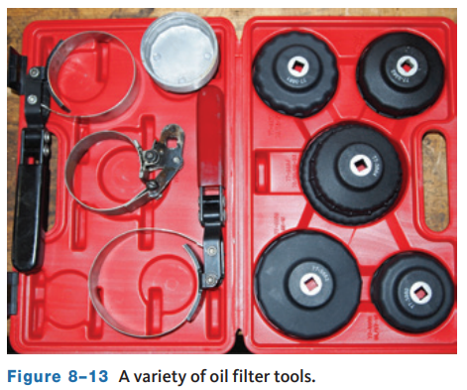
Oil Filter
The oil pumped through the system passes through an oil filter.
This filter is changed with the oil.
There are many shapes and sizes of filters, and each may require a special tool to remove and install one.
Always use a filter that meets at minimum the OE filtration specifications

Slide 20
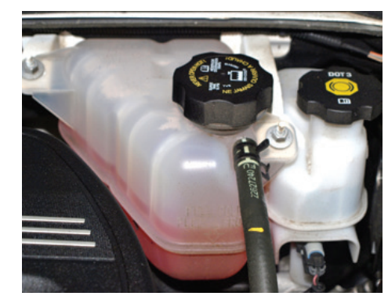
Cooling System (1 of 2)
Whenever you change an engine’s oil, you should also do a visual inspection of the different systems under the hood, including the cooling system.
Inspect all cooling system hoses for signs of leakage and/or damage.
Replace all hoses that are swollen, cracked, or show signs of leakage.
The radiator should also be checked for signs of leaks; if any are evident the radiator should be repaired or replaced.
The level and condition of the engine’s coolant should also be checked. Check the coolant’s level at the coolant recovery tank. It should be between the “low” and “full” lines.

Slide 21
Cooling System (2 of 2)
Coolant
  Engine coolant is a mixture of water and antifreeze.
    Recommended mixture is 50/50 water and antifreeze.
  Five types of coolant are commonly available, most of which are ethylene glycol based.
    Inorganic acid technology (IAT)
    Propylene glycol
    Phosphate-free
    Organic acid technology (OAT)
    Hybrid organic acid technology (HOAT)
    Manufacturer-specific coolants

Slide 22
Knowledge Check (2 of 3)
  The oil pumped through the system passes through an _____ _____.

Slide 23
Knowledge Check Answer (2 of 3)
  The oil pumped through the system passes through an _____ _____.
  Answer: The oil pumped through the system passes through an oil filter.

Slide 24
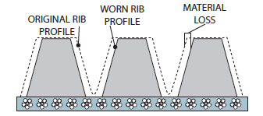
Drive Belts
V-belts and V-ribbed belts (serpentine belts) are used to drive water pumps, power-steering pumps, air-conditioning compressors, generators, and emission control pumps.
Slippage can be caused by improper belt tension or oily conditions. When there is slippage, the support bearing of the component driven by the belt can be damaged.
As a V-belt wears, it begins to ride deeper in the groove. This reduces its tension and promotes slippage.
Because this is a normal occurrence, periodic adjustment of belt tension is necessary. Drive belts can be used to drive a single part or a combination of parts. An engine can have three or more V-belts.

Slide 25
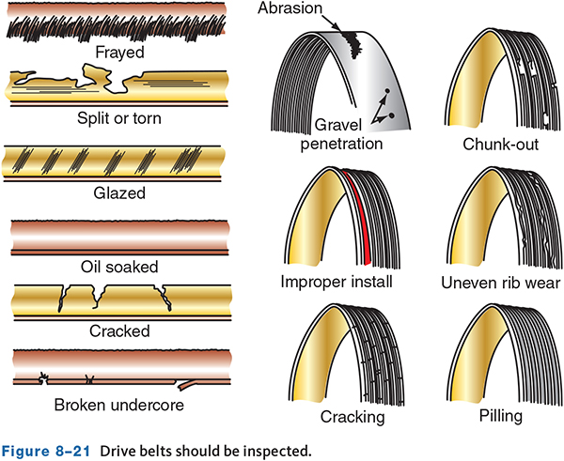
Drive Belts Inspection
Check the condition of all of the drive belts on the engine.
Carefully look to see if they have worn or glazed edges, tears, splits, and signs of oil soaking.
Inspect the grooves of the pulleys for rust, oil, wear, and other damage. If a pulley is damaged, it should be replaced. Rust, dirt, and oil should be cleaned off the pulley before installing a new belt.
Misalignment of the pulleys reduces the belt’s service life and brings about rapid pulley wear, which causes thrown belts and noise.

Slide 26
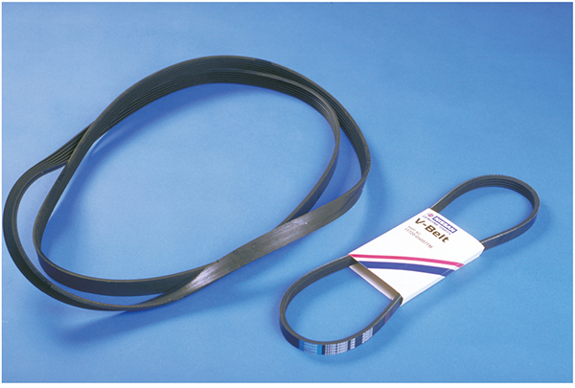
Belt Replacement
08.04 List at least six examples of typical preventive maintenance services
If a drive belt is damaged, it should be replaced.
If there is more than one drive belt, all should be replaced even if only one is bad.
You can verify that the new belt is a replacement for the old one by physically comparing the two. This, however, does not account for any belt stretch that may have occurred. Therefore, only use this comparison as verification.
The best way to select the correct replacement belt is with a parts catalog and/or by matching the numbers on the old belt to the numbers on the new belt.

Slide 27
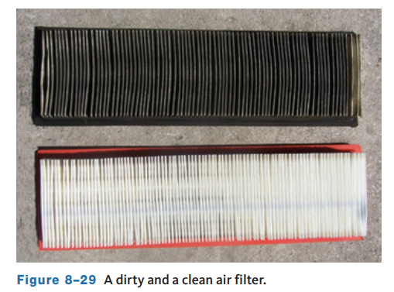
Air Filters
Most air filters are made of pleated paper to increase the filtering area.
As a filter gets dirty, the amount of air that can flow through it is reduced.
This is not a problem until less air than what the engine needs can get through the filter; however, an air filter needs to be nearly completely restricted before it will affect engine performance.
Without the proper amount of air, the engine will not be able to produce the power it should; nor will it be as fuel efficient as it should be.
Included in the PM plan for all vehicles is the replacement of the air filter.

Slide 28
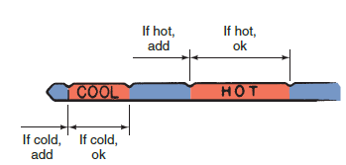
Transmission Fluid (1 of 2)
The oil used in automatic transmissions is called automatic transmission fluid (ATF) and is dyed red so that it is not easily confused with engine oil.
Before checking the fluid, make sure to check and follow the fluid inspection procedures.
These typically include operating the vehicle until the fluid is at operating temperature, transmission in Park and the vehicle on a flat surface, engine at idle.
Check the level of the fluid on the dipstick.
If the transmission does not have a dipstick, refer to the service information for the steps to check the fluid level.

Slide 29
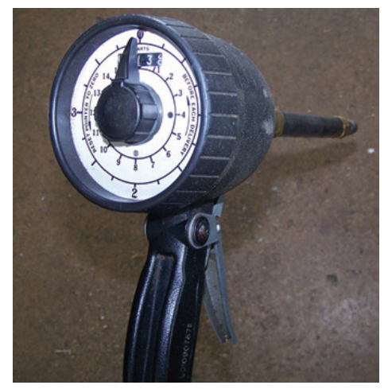
Transmission Fluid (2 of 2)
Manual Transmissions
  Manual transmissions, transaxles, and drive axle units require the use of specific lubricants or oils.
  The levels should be checked according to the recommended time frames.
  Some manufacturers recommend that the fluids be periodically changed.
  Many shops have a dispenser type pump to add fluid.

Slide 30
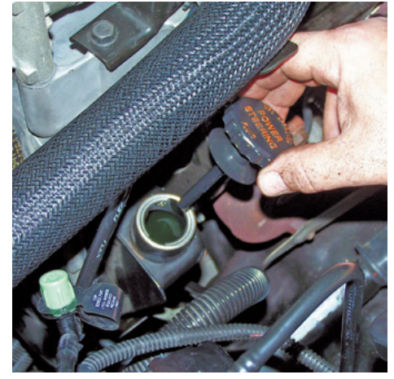
Power-Steering Fluid
Normally, the power-steering fluid level is checked with the engine warm but turned off.
If the fluid is cold, it will read lower than normal.
The filler cap on the power-steering pump normally has a dipstick.
Unscrew the cap and check the level.
  Add fluid as necessary.

Slide 31
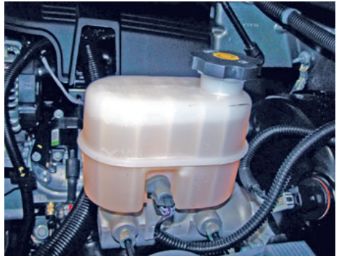
Brake Fluid (1 of 2)
Brake fluid levels are checked at the master cylinder.
Most new plastic reservoirs are translucent and allow the fluid level to be observed from the outside.
Do not open the master cylinder reservoir unnecessarily as this allows air and moisture to contact the brake fluid. While checking the fluid level, look at the color of the fluid.
Brake fluid tends to absorb moisture, and its color gives clues as to the moisture content of the fluid.
Dark- or brown-colored fluid indicates contamination, and the system may need to be flushed and the fluid replaced.
When it is necessary to add brake fluid, make sure the fluid is the correct type and is fresh and clean.

Slide 32
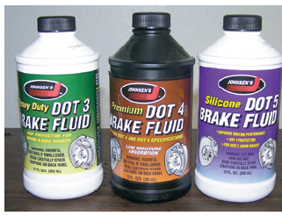
Brake Fluid (2 of 2)
There are currently four general types of brake fluids:
  DOT 3
  DOT 4
  DOT 5
  DOT 5.1
DOT 3, DOT 4, and DOT 5.1 fluids are polyalkyleneglycol-ether mixtures, called “polyglycol” for short. The color of both DOT 3 and DOT 4 fluid ranges from clear to light amber.
DOT 5 is silicone based and is not compatible with the other fluids.
DOT 5.1 is chemically similar to DOT 3 and 4 and is technically compatible.

Slide 33
Diesel Exhaust Fluid
Newer diesel engine vehicles use a special diesel exhaust fluid (DEF) made of 33 percent urea and 67 percent pure deionized water.
This mixture is stored in a tank and is injected into the diesel exhaust after-treatment system to reduce NOx emissions.
How often the tank needs to be filled depends on the vehicle’s operating conditions.
If the tank runs out, the on-board computer system will limit engine and vehicle speed until the tank is refilled.
Fluid tanks are filled either under the hood or through a filler neck near the diesel fuel cap.

Slide 34
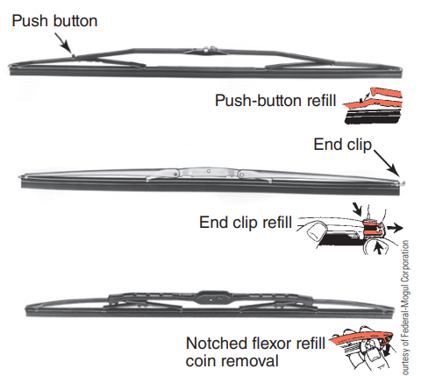
Windshield Wipers
Wiper blades can become dull, torn, or brittle; if they are, they should be replaced.
Check the condition of the wiper arms, looking for signs of distortion or damage.
Check the spring on the arm. This spring is designed to keep the wiper blade fairly tight against the windshield. If the spring is weak or damaged, the blade will not do a respectable job cleaning the glass.
Most wiper blade assemblies have replaceable blades or inserts.
When servicing, be very careful not to damage the glass windshield.

Slide 35
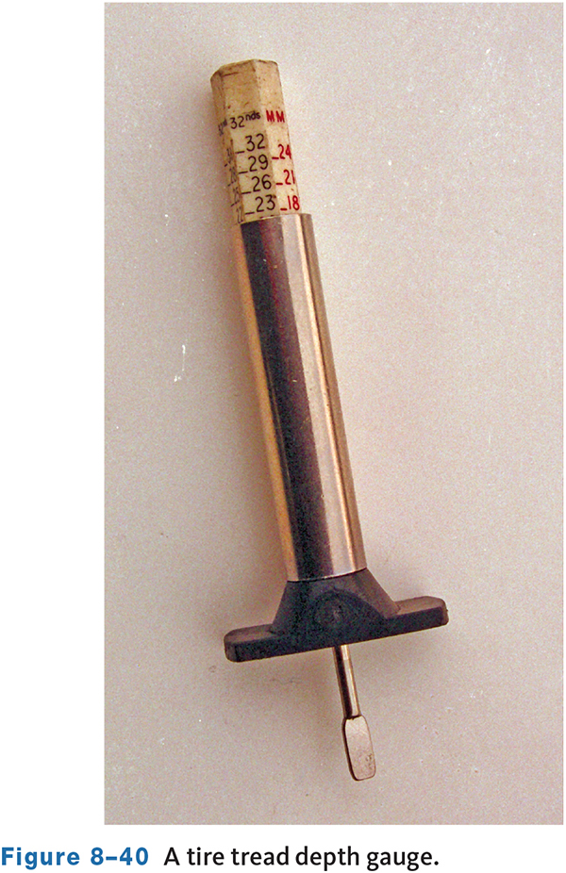
Tires (1 of 3)
The vehicle’s tires should be checked for damage and wear.
Tires should have at least 1/16-inch (2/32nds) of tread remaining.
Any less and the tire should be replaced.
Tires have “tread wear indicators” molded into them.
When the wear bar shows across the width of the tread, the tire is excessively worn.
A tire wear gauge gives an accurate measurement of the tread depth.

Slide 36
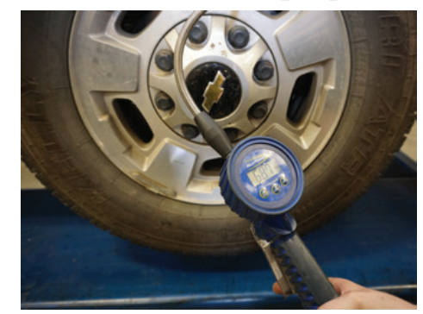
Tires (2 of 3)
Check the inflation of the tires.
Press the gauge firmly onto the tire’s valve stem, the air pressure in the tire will push the scale out of the tool, and the highest number shown on the scale is the air pressure of the tire.
Compare this reading with the specifications for the tire.
The correct tire pressure is listed in the vehicle’s owner’s manual or on a decal (placard) stuck on the driver’s doorjamb.
The air pressure rating on the tire is not the amount of pressure the tire should have. Rather this rating is the maximum pressure the tire should ever have when it is cold.
Vehicles built since 2010 are fitted with tire pressure monitoring systems (TPMS).

Slide 37
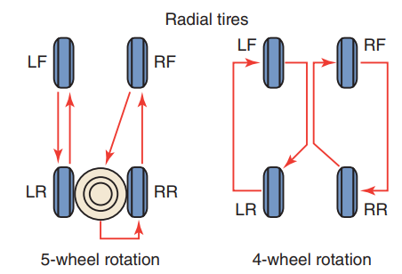
Tires (3 of 3)
Tire Rotation
  To equalize tire wear, most car and tire manufacturers recommend that the tires be rotated.
  Front and rear tires perform different jobs and can wear differently.
  To equalize wear, it is recommended that tires be rotated.
  Radial tires should be initially rotated at 7,500 miles and then at least every 15,000 miles thereafter.

Slide 38
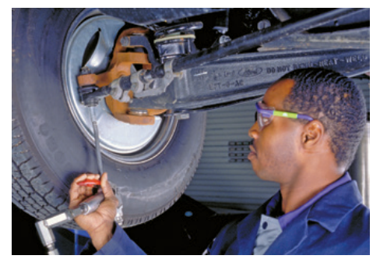
Chassis Lubrication
A PM procedure that is becoming less common because of changing technology is chassis lubrication. however, all technicians should know how to do this.
During the lubrication procedure, grease is forced between two surfaces that move or rub against each other. The grease reduces the friction produced by the movement of the parts.
During a chassis lube, grease is forced into a pivot point or joint through a grease fitting.
Grease fittings are found on steering and suspension parts, which need lubrication to prevent wear and noise caused by their action during vehicle operation. Grease fittings are called zerk fittings and are threaded into the part that should be lubricated.

Slide 39
Greases
Greases are made from oil blended with thickening agents.
There are a few synthetic greases available that meet the same standards as petroleum greases.
The thickening agent increases the viscosity of the grease. Greases are categorized by a National Lubricating Grease Institute (NLGI) number and by the thickeners and additives that are in the grease.
Some greases are also labeled with an “EP,” which means they have extreme pressure additives. The number assigned by the NLGI is based on test results and the specifications set by the American Society for Testing Materials (ASTM).
NLGI grade | Worked penetration after 60 strokes at 77°F (25°C) | Appearance
000 | 44.5-47.5 mm | fluid
00 | 4.00-4.30 mm | fluid
0 | 3.55-3.85 mm | very soft
1 | 3.10-3.40 mm | soft
2 | 2.65-2.95 mm | moderately soft
3 | 2.20-2.50 mm | semifluid
4 | 1.75-2.05 mm | semifluid
5 | 1.30-1.60 mm | hard
6 | 0.85-1.15 mm | very hard
Figure 8-49 The table shows the NLGI grades and the worked penetration ranges.

Slide 40
Knowledge Check (3 of 3)
At what tread depth reading does a tire need to be replaced?

Slide 41
Knowledge Check Answer (3 of 3)
At what tread depth reading does a tire need to be replaced?
Answer:
Tires should have at least 1/16 or 2/32nds inch of tread remaining. Any less and the tire should be replaced.

Slide 42
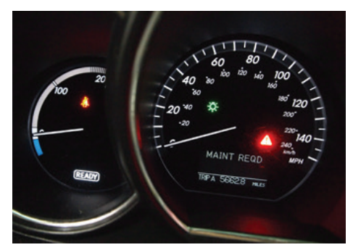
Hybrid Vehicles (1 of 2)
Hybrid vehicles are maintained and serviced in the same way as conventional vehicles, except for the hybrid components which include the high-voltage battery pack and circuits which must be respected when doing any service on the vehicles.
One of the things to pay attention to is the stop start feature you need to know when the engine will normally shut down and restart.
Without this knowledge, or the knowledge of how to prevent this, the engine may start on its own when you are working under the hood.
Make sure the “READY” lamp in the instrument cluster is off; this lets you know the system is also off.

Slide 43
Hybrid Vehicles (2 of 2)
Care needs to be taken to avoid anything orange while carrying out the maintenance procedures.
The engines used in hybrids are modified versions of engines found in other models and less freedom in deciding the types of fluids that can be used and the parts that can replace the original equipment.
Typically, the engine oil used in a hybrid is very light, for example, 0W-20 or 0W-16 oil. If heavier oil is used, the computer may see this as a problem and prevent the engine from starting.
Most hybrids have two cooling systems, one for the engine and one for the hybrid drive systems and/or battery packs. These cooling systems do not intermix, and different coolants are used in each.
Basic items such as tires, brakes, and wheel alignment can have a negative effect, and owners of hybrids will notice the difference. These owners are constantly aware of their fuel mileage due to the displays on the instrument panel.

Slide 44
Additional PM Checks (1 of 2)
The following are some PM checks that should be performed at these suggested time intervals.
  Time: While operating the vehicle.
    Pay attention to and note any changes in the sound of the exhaust or any smell of exhaust fumes in the vehicle.
    Check for vibrations in the steering wheel.
    Check the parking brake
  Time: At least monthly
    Check the operation of all exterior lights, including the brake lights, turn signals, and hazard warning flashers.

Slide 45
Additional PM Checks (2 of 2)
Time: At least twice a year
  Check the pressure in the spare tire.
  Check headlight alignment.
  Check the muffler, exhaust pipes, and clamps.
Time: At least once a year
  Lubricate all hinges and all outside key locks.
  Lubricate the rubber weather strips for the doors.
  Clean the body’s water drain holes.

Slide 46
Chapter Reflection
Please take a moment to compare your perception of the automotive industry before and after you studied this chapter. Then respond to the following questions in one or two paragraphs. Use 150–200 words in your reflection.
Did anything in this chapter change your thinking about preventative maintenance?
Considering all you have learned, do you feel you are able to apply basic maintenance theories when performing this type of work?

